Slide 1
Getting Started Successfully On Bloomz as a Student
Using A Class Access Code

Slide 2
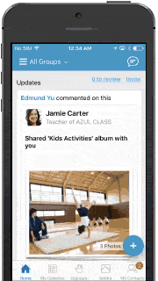
Bloomz is an app that helps you stay updated on what’s happening in your classroom & school.
See quick updates from the teacher, pictures of classroom activities, class calendars, & more.
Notes:
Summary of Bloomz for parents.

Slide 3
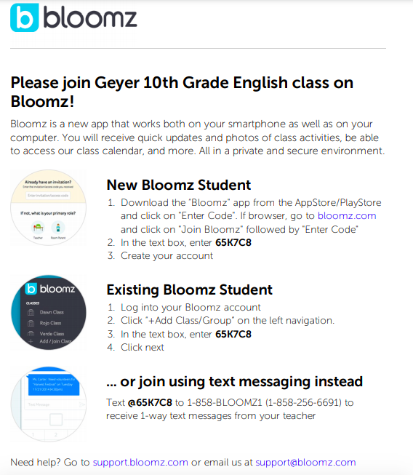
Class Access Code
You should have received a handout or a class code from your teacher. It might look similar to this
You can join using text messaging (follow directions on handout from your teacher) and/or on the app or computer.
Notes:
NOTE: Joining by just text messages will only have the 1 way alerts and messages from the teacher. It is recommended that students join by creating an account on the app or through bloomz.com.
If students would like to ALSO receive text messages, they would need to create the account, and join the text messaging by texting the specific code to the number provided by the teacher.
NOTE for Teacher: Students could potentially have “2” accounts in your classroom- one created through text message and one created through email.

Slide 4
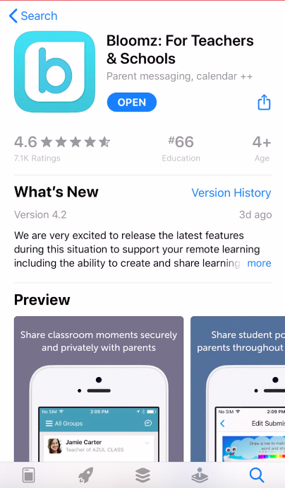
To Register on the Computer or Bloomz App:
Go to www.bloomz.com or download the Bloomz app to your smartphone.
On the desktop click “Sign In”.
On the app, open up the app after it is downloaded to your device.
Notes:
Follow these directions to create an account on Bloomz.com or on the app.

Slide 5
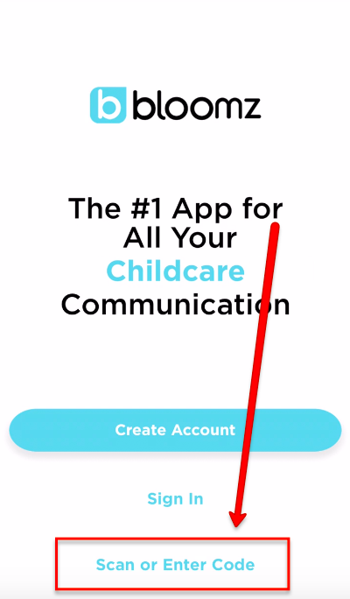
Click “Scan or Enter Code”. Follow prompts to enter Class Access code.

Slide 6
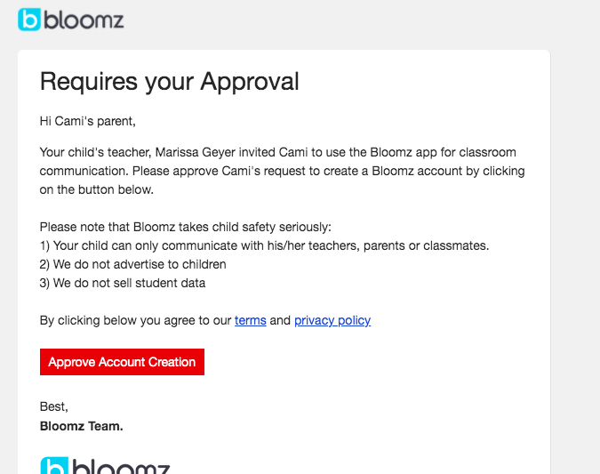
Enter your information.
NOTE: If you are under 14 years old, this will send an email or text to your parents to verify your account.
(Example of how this will look to parents in text or email).
Notes:
Once a parent approves the account, the student will be able to log in and see the main page of Bloomz.

Slide 7
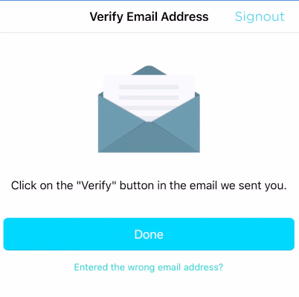
This will also send a verification email to your email address.
You will need to log into your email and “Verify” your Bloomz account.

Slide 8
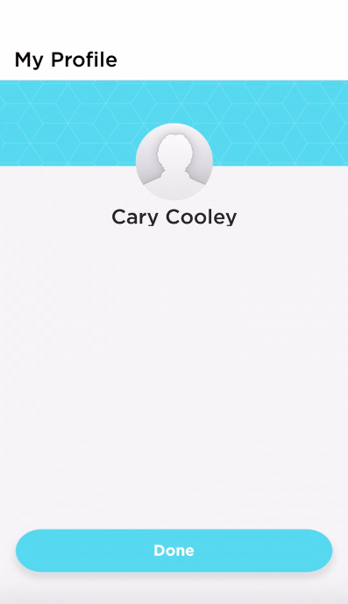
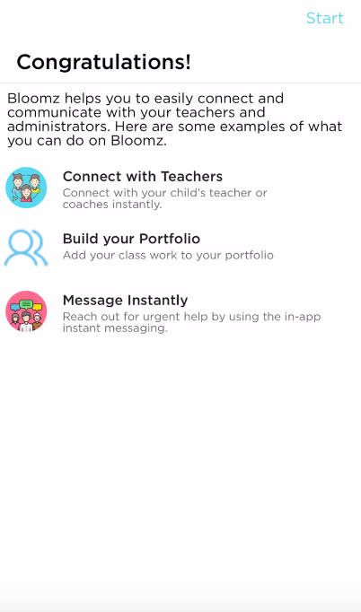
Welcome to Bloomz! Next time you log in, you will click “Done” and then see a “Congratulations” message. Press start.

Slide 9
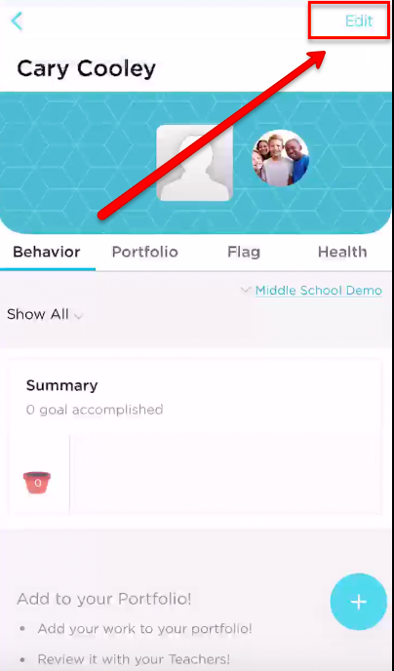
Click “Edit” to add your profile picture.
Use the “+” icon in the bottom right-hand corner to add posts/content.

Slide 10
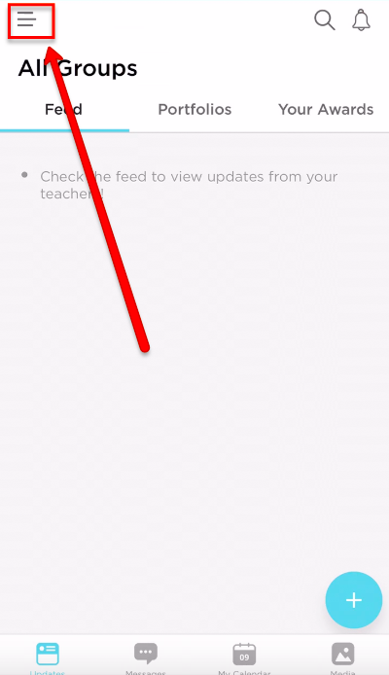
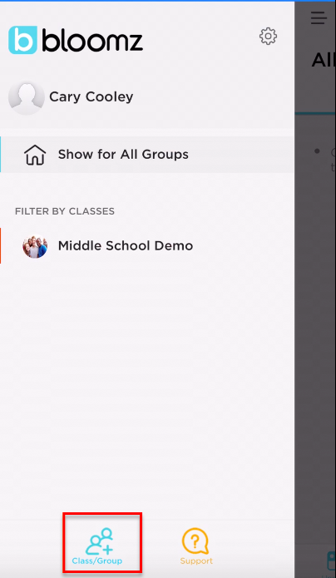
Joining additional classes/groups?
Click the feed button in the top left-hand corner.
Click “+ Class/Group”.

