Slide 1
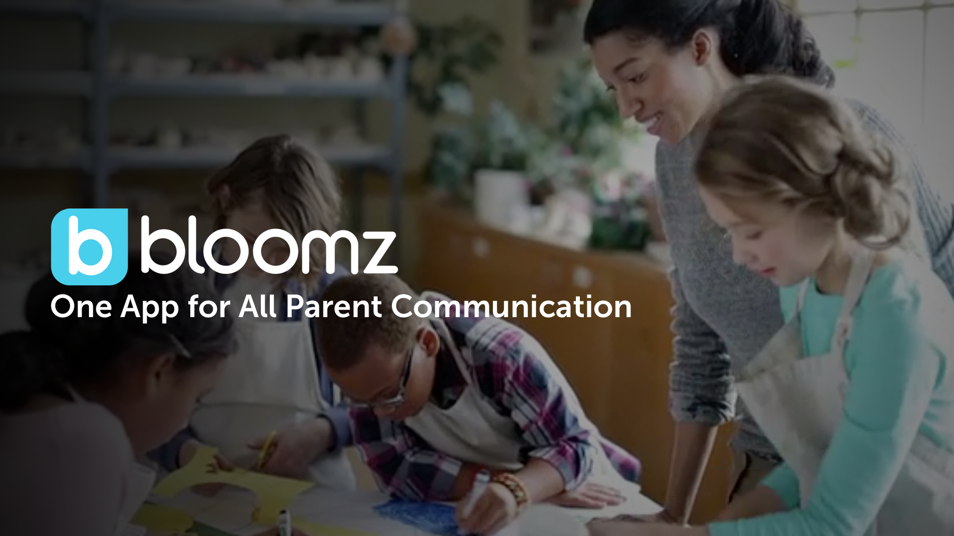
Getting Started Successfully On Bloomz as a Student
Using Student Specific Access Codes

Slide 2
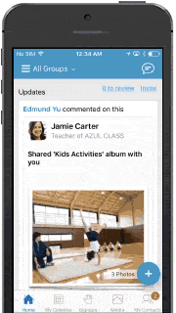
Bloomz is an app that helps you stay updated on what’s happening in your classroom & school.
See quick updates from the teacher, pictures of classroom activities, class calendars, & more.
Notes:
Summary of Bloomz for parents.

Slide 3
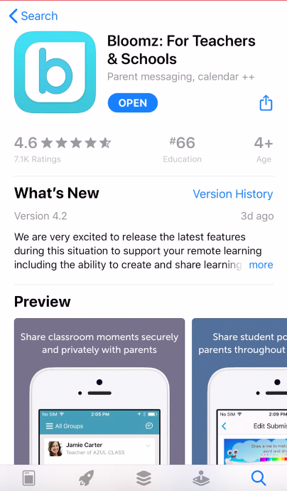
Beginning with Bloomz
Go to www.bloomz.com or download the Bloomz app to your smartphone.
On the desktop click “Sign In”.
On the app, open up the app after it is downloaded to your device.

Slide 4
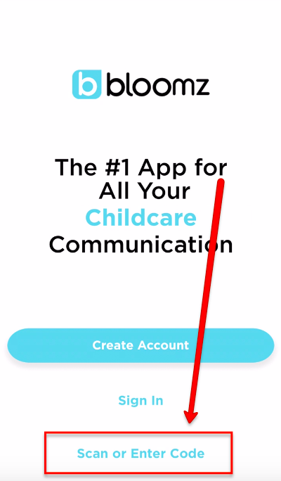
Click “Scan or Enter Code”.
NOTE: This is a “student specific” access code that is unique to JUST you.

Slide 5
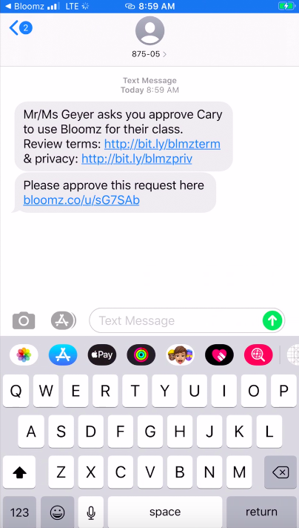
Enter your information.
NOTE: If you are under 14 years old, this will send an email or text to your parents to verify your account.

Slide 6
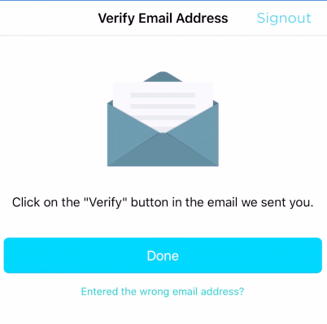
This will also send a verification email to your email address.
You will need to log into your email and “Verify” your Bloomz account.

Slide 7
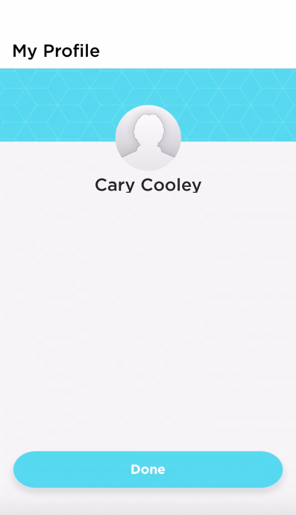
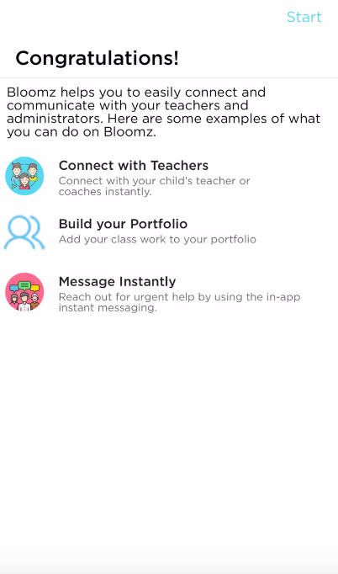
Welcome to Bloomz! Next time you log in, you will click “Done” and then see a “Congratulations” message. Press start.

Slide 8
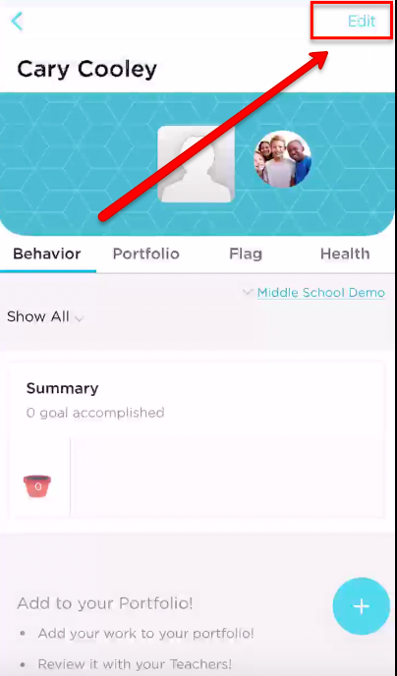
Click “Edit” to add your profile picture.
Use the “+” icon in the bottom right-hand corner to add posts/content.

Slide 9
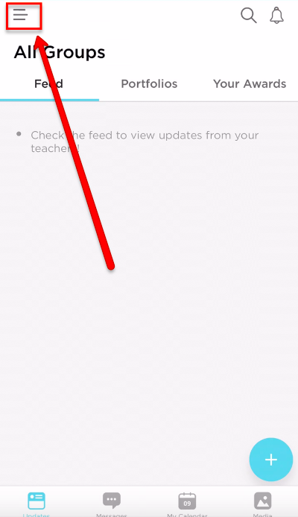
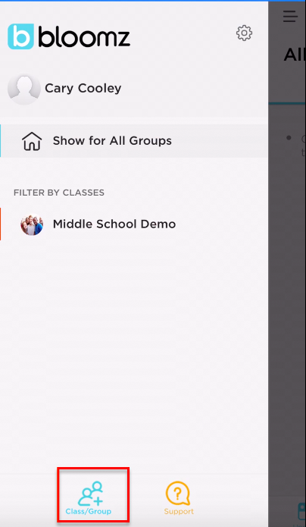
Joining additional classes/groups?
Click the feed button in the top left-hand corner.
Click “+ Class/Group”.

